Slide 1








Our Moto
The mission of MSE is to provide a safe atmosphere of mutual respect that promotes self –esteem, self-control and responsibility.
Donations
If you’d like to support our learning space , here are some items we often use and appreciate throughout the year: tissue, disinfecting wipes, paper towels, snacks (chips, cookies, etc.) and ziplock bags (all sizes).
Welcome to a super Kindergarten Year
Classroom
Expectations
Listening
Ears
Quiet mouths
Looking
Eyes
Walking Feet
Parent
Volunteer
We love having parent volunteers in our kindergarten classroom! Whether you can help during centers, assist with classroom prep, read a story to the class, or join us on a field trip, your time and support make a big difference. Look out for volunteering training dates.
Mrs. Trobaugh
Room # 13
Email: trobavi@boe.richmond,k12.ga.us
Text Messages through class dojo
Field Trip
Field Trips – Coming Soon!
Stay tuned!

Slide 2

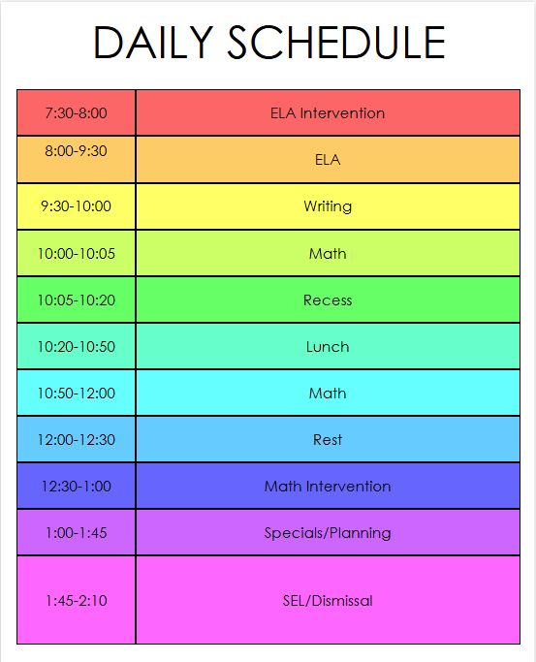
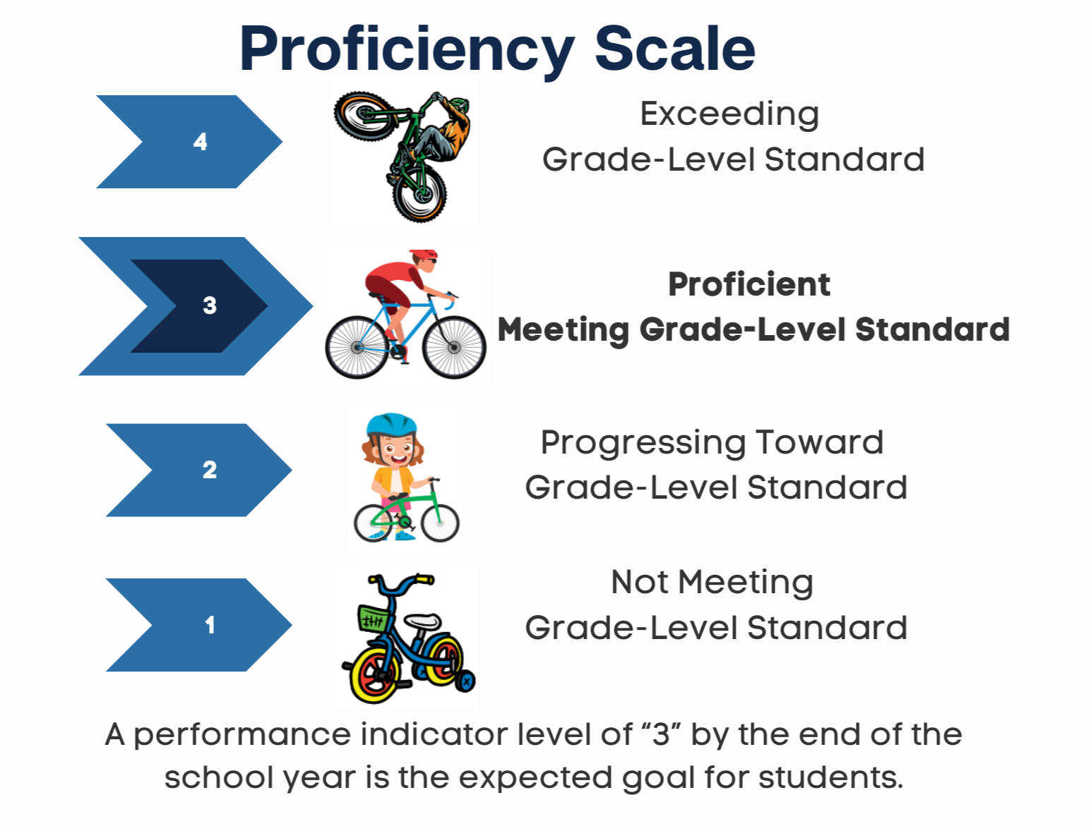
This is typically what my daily schedule will look like. It may change once school is underway. |  | Each month, you’ll receive a homework calendar with simple activities to do with your family. There’s no pressure to submit anything—just spend about 30 minutes learning together each day!
Goals
Homework
Math Goals
Count to 100 by ones and tens
Recognize and write numbers 0–20
Understand basic addition and subtraction within 10
Identify and describe 2D shapes (circle, square, triangle, rectangle)
Sort and categorize objects by size, color, or shape
Create and recognize patterns (e.g., AB, ABB)
Literacy Goals
Recognize uppercase and lowercase letters
Produce letter sounds (phonemic awareness)
Read and write simple CVC (consonant-vowel-consonant) words like “cat” or “sun”
Identify sight words (e.g., “the,” “is,” “and”)
Retell stories with beginning, middle, and end
Use invented spelling to write simple sentences
Grades
Technology
We use technology in a balanced and thoughtful way. Whether it’s listening to a story on the tablet, playing a math game, or using digital art tools, kids get hands-on experience with tools that support their learning and spark imagination.

